Slide 1
Excercise 5
Authors: Felix Findeisen; Lucas Janssen
Group: 3
Notes:
„

Slide 2
Task 1 - Automatic Evaluator

Slide 3
1 Approach
Automated extraction of Tasks, Events & Gateways
Choosing Method: Structured Outputs
Automatic computation of precision & recall values
Run for 3 different descriptive texts of BMPN models

Slide 4
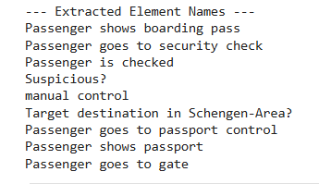
1a) Automated extraction of Tasks, Events & Gateways

Slide 5
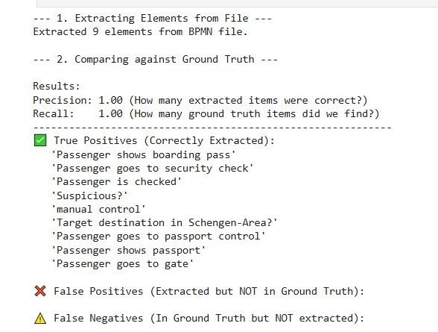
1b) & 1c) Choosing Method: Structured Outputs

Slide 6
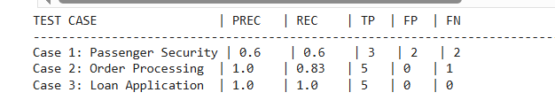
1d) Run for 3 different descriptive texts of BMPN models

Slide 7
Task 2 - Adaptation

Slide 8



1 Structure: Retrieval Augmented Generation
User Query
Query +
Documents
Query
Prompt Builder
Response
Output
LLM
User
Query
Relevant
Documents
Embedding Model
Embeddings
Embeddings
Embedding Model
Documents
Doc Database
Docs

Slide 9
1 Structure: This RAG Structure
User Query with XML and Description
Query +
Rules
Query
Prompt Builder
Response
Output
LLM
User
Query with Error-Type
Relevant
Rules
Rules with Metadata
ErrorRuleRetriever
Docs

Slide 10
2 Code
Do all Imports
Custom Retriever: rule based
Document Store: filled with rules
Prompt Builder: include Model, Text, Document Store with Instructions and Target
Generator: Ollama 3.2
Assembling the pipeline: Components
Execution/ Pipeline Run

Slide 11
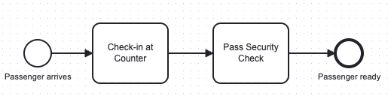

3 Result (1/3): Missing Task
Wrong Description:
The passenger arrives at the terminal.
First, they proceed to Check-in at Counter to drop their bags.
Finally, the Passenger is ready to board.
Corrected Description:
The passenger arrives at the terminal.
First, they proceed to Check-in at Counter to drop their bags and then undergo security checks.
Finally, the Passenger is ready to board.
Result:
100% correct, nothing wrongly added or changed, just the addition „security check“

Slide 12
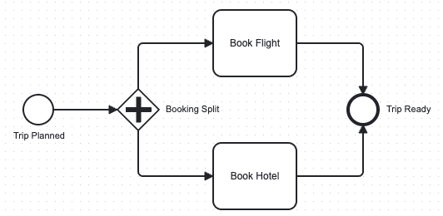
3 Result (2/3): Missing Gateway
Wrong Description:
When a trip is planned, we first Book Flight.
After that is done, we proceed to Book Hotel.
Finally, the trip is ready.
Corrected Description:
When a trip is planned, we first Book Flight and simultaneously Book Hotel.
After both tasks are completed, the trip is ready.
Result:
100% correct, nothing wrongly added or changed, just rewrite with parallel execution

Slide 13
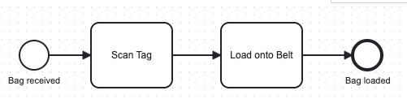
3 Result (3/3): Hallucinated Task
Wrong Description:
The baggage handling process starts when a bag is received.
First, the worker scans the tag.
Then, they wrap the bag in protective plastic.
Then, they load it onto the belt.
Finally, a bag is loaded
Corrected Description:
The baggage handling process starts when a bag is received.
First, they scan the tag.
Then, they load it onto the belt.
Finally, a bag is loaded.
Result:
100% correct, nothing wrongly added or changed, just rewrite removing the plastic protection (+ it is not said, that any worker scans the Tag, so this was proactively removed aswell, which I did wrongly in the Description)

Slide 14
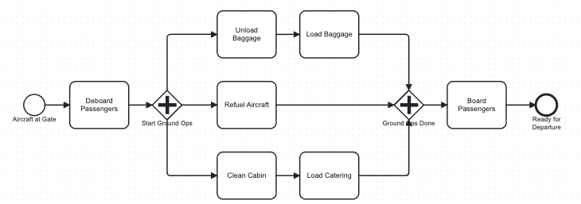

4 Critics: Only small BPMN Models – Add On
Wrong Description:
As soon as the aircraft arrives at the gate, the passengers de-board immediately.
While the ground crew refuels the aircraft, the flight attendants prepare for the next flight.
Once refueling is complete, the new passengers board the plane, and the aircraft is ready for departure.
Corrected Description:
As soon as the aircraft arrives at the gate, the passengers de-board immediately.
While the ground crew refuels the aircraft, the flight attendants prepare for the next flight and clean the cabin.
Once refueling is complete, the new passengers board the plane, and the aircraft is ready for departure.
Only one out of 4 missing tasks were replaced and correcte

Slide 15
5 Summary
Key Successes
Structured Context: Injecting specific error types (e.g., "missing task") significantly improves precision and generation speed compared to generic prompts in comparison to missing these (previous task-sheet)
Current Limitations
Multi-Error Handling: The pipeline struggles to correct multiple missing tasks simultaneously (edge cases).
Over-Correction: Valid textual context (e.g., specific roles like “worker") is correctly removed if not explicitly modeled in BPMN. This leads to…:
Steerability: Despite deterministic settings (Temp 0.0), the model occasionally ignores strict constraints and alters the writing style.

Slide 16
Task 3 - LLM as a Judge

Slide 17
3 Approach
Let LLM evaluate readability with score
Run 3 different BPMN models & compare text written by myself (Ground Truth) with generated → compare scores
Other useful metric to evaluate descriptive texts (apart from precision/recall and metrics from 3a)

Slide 18
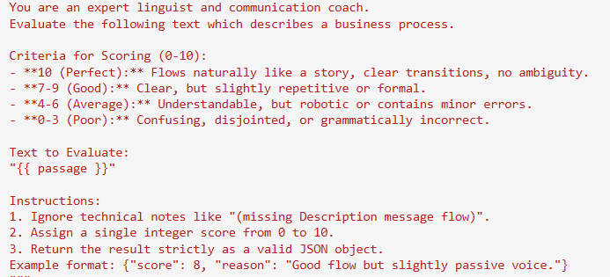
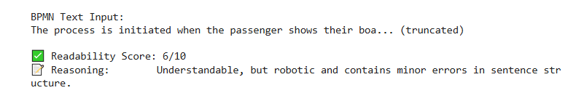
3a) Let LLM evaluate readability with score
Prompt
Output

Slide 19
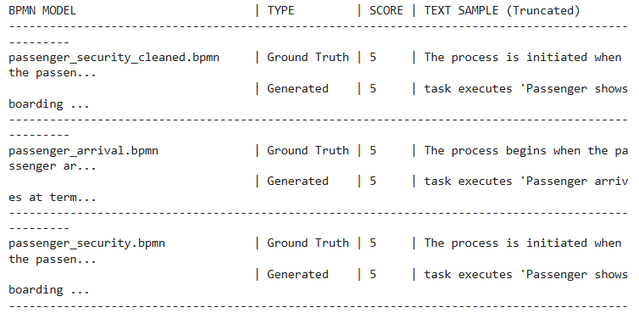
3b) Run 3 different BPMN models

Slide 20
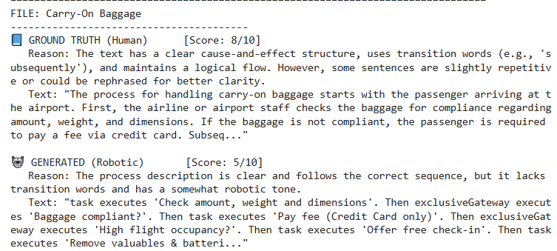
3c)* Other useful metric (1/3)

Slide 21
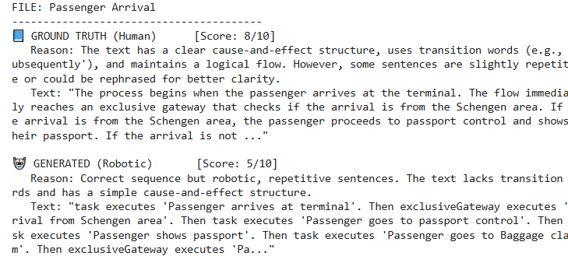
3c)* Other useful metric (2/3)

Slide 22
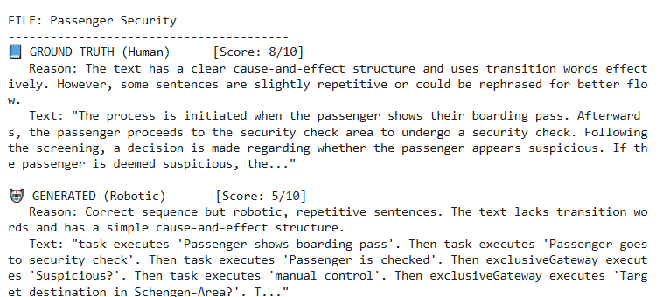
3c)* Other useful metric (3/3)

